Slide 1
Cotton Analysis Assignment SUBMISSION
Group Name:
Shwetank Pandey- 2235191
Mridul Sharma- 2235157

Slide 2

Problem Solving Methodology- CRISP DM Framework
Business Objective : Explained Above Slide
Data : Present in Excel Format, Information about all companies and details about Investment in them and mapping of primary sectors to their main sectors
Data Preparation : Cleaning of the data available by replacing the NA values with meaningful values wherever necessary.
Modelling: Applying a Model following the constraints above and sorting
the results step by step coming to a conclusion for completing the objective.
Evaluation: Evaluating the results in different tools, reviewing the
process and summarizing the results keeping the business success
constraints in mind(Above Slide)
Tools Used : R, Excel

Slide 3
Problem Objective
National Cotton Fabric Association Board has observed a decline in domestic cotton sales and product and wants to:
Understand and estimate the impact of whole sale price and imports on cotton sales and production
Leverage the demand model to determine the price that will maximize the total revenue
Results
The decline in cotton sales and production is primarily driven by increase in the whole sale price of the cotton. The import of cotton marginally impacts the cotton sales and production. In order to increase the revenue from cotton sales, the whole sale price of cotton should be reduced to a level of $ 98 /lb at which the total quarterly revenue will hit a maximum of $ 213,395

Slide 4
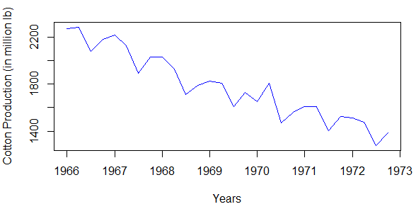
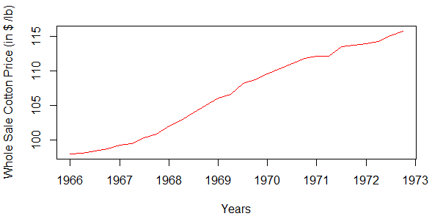
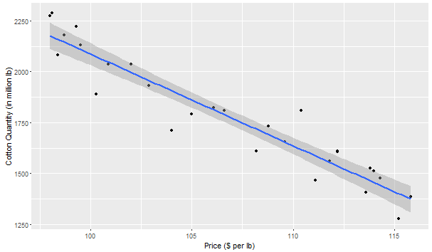
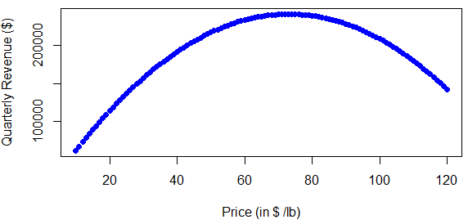
Analysis Results
Cotton production follows linearly decreasing trend with seasonality
Wholesale cotton price follows linearly increasing trend without seasonality
Prod = 6599.84 – 45.126*price
Maximum in data range
R² = 0.9022 and p < 0.05
Global Maximum
$73/lb
$98/lb
Cotton production and price holds linearly decreasing relationship
Total Revenue increases till the price of $73/lb and decreases thereafter
Import and Exports don’t impact the cotton production markedly
A unit increase in imports will lead to decrease in production by 6.5175 units
A unit increase in exports will lead to increase in production by 0.3190 units
A balanced trade of a unit will lead to decrease in production by 6.1985 units
Prod = 6757.0093 - 46.9564*price - 6.5175*import + 0.3190*export
R² = 0.9347 and p < 0.05

